Slide 1


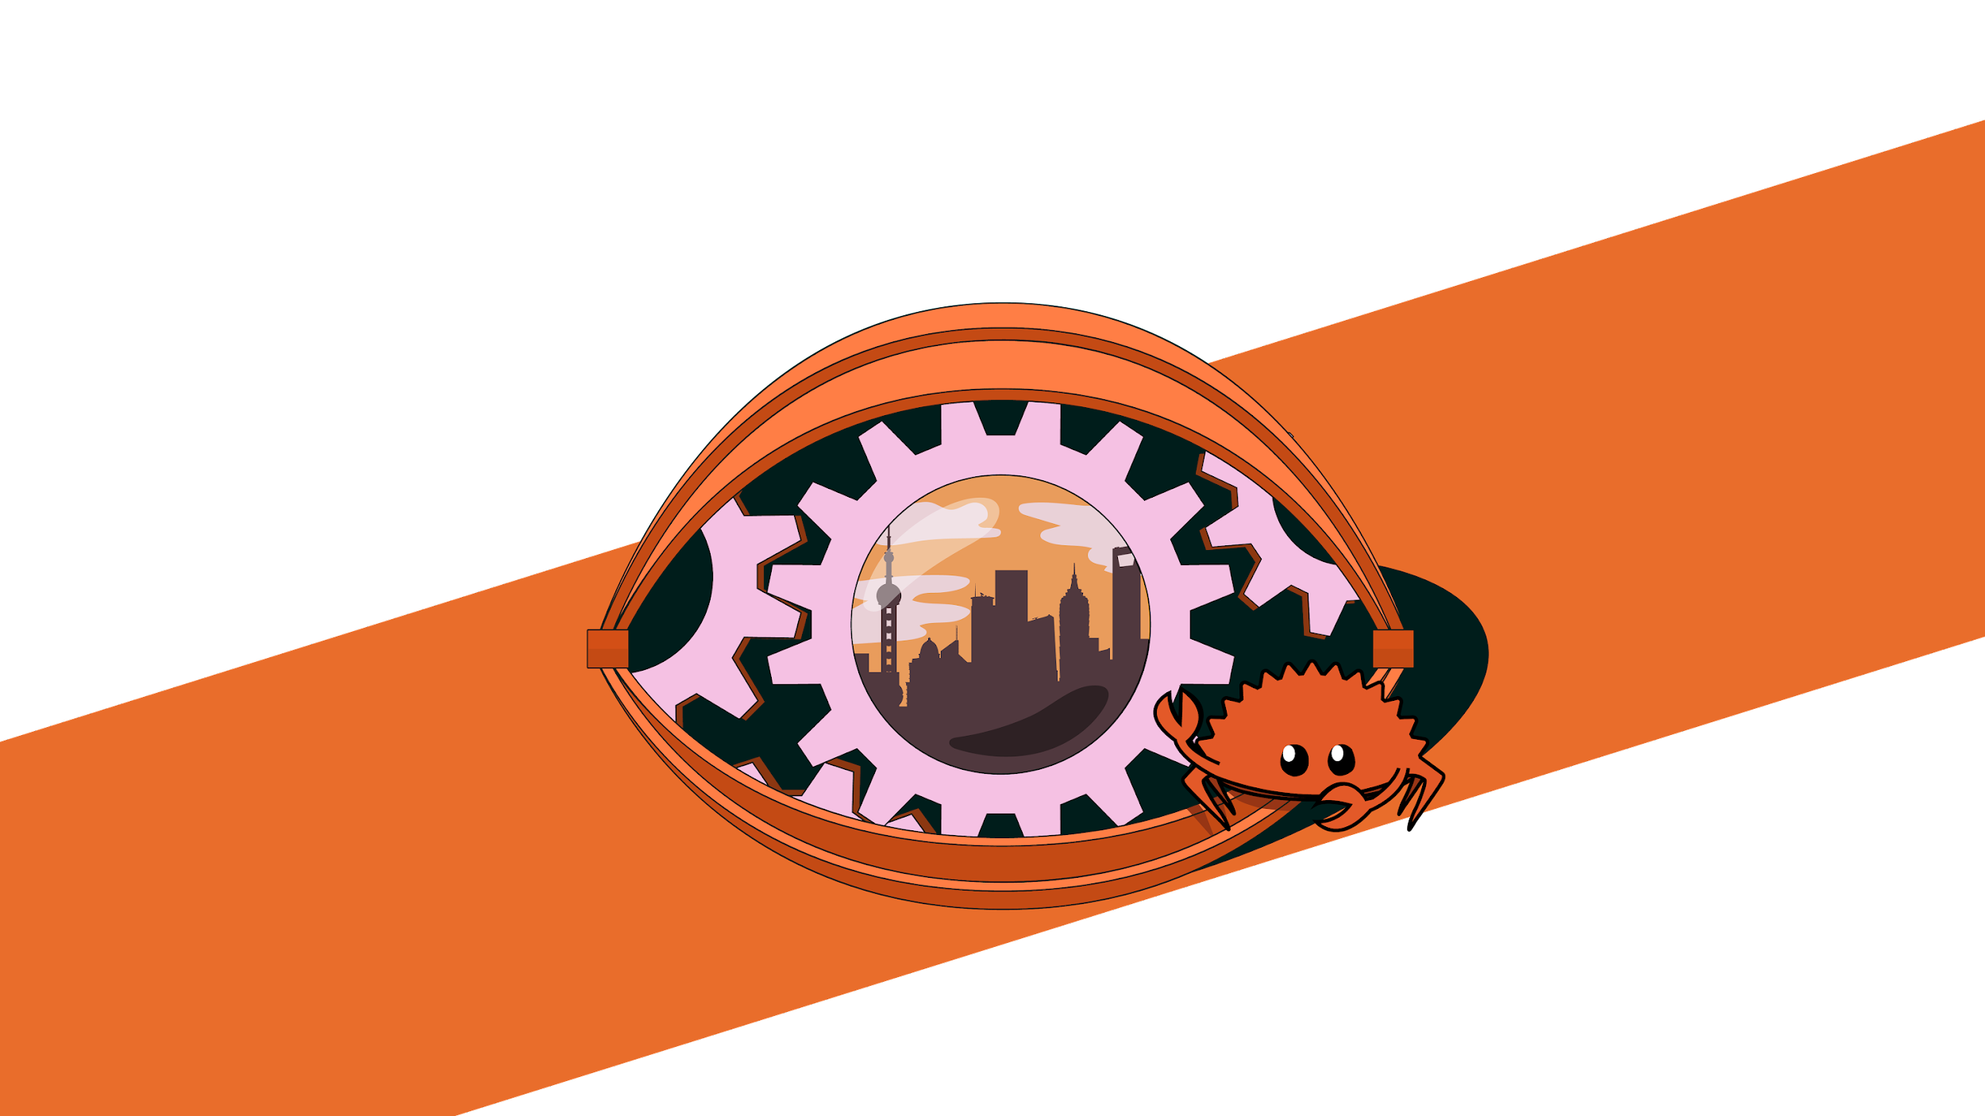

第三届中国Rust开发者大会

Slide 2
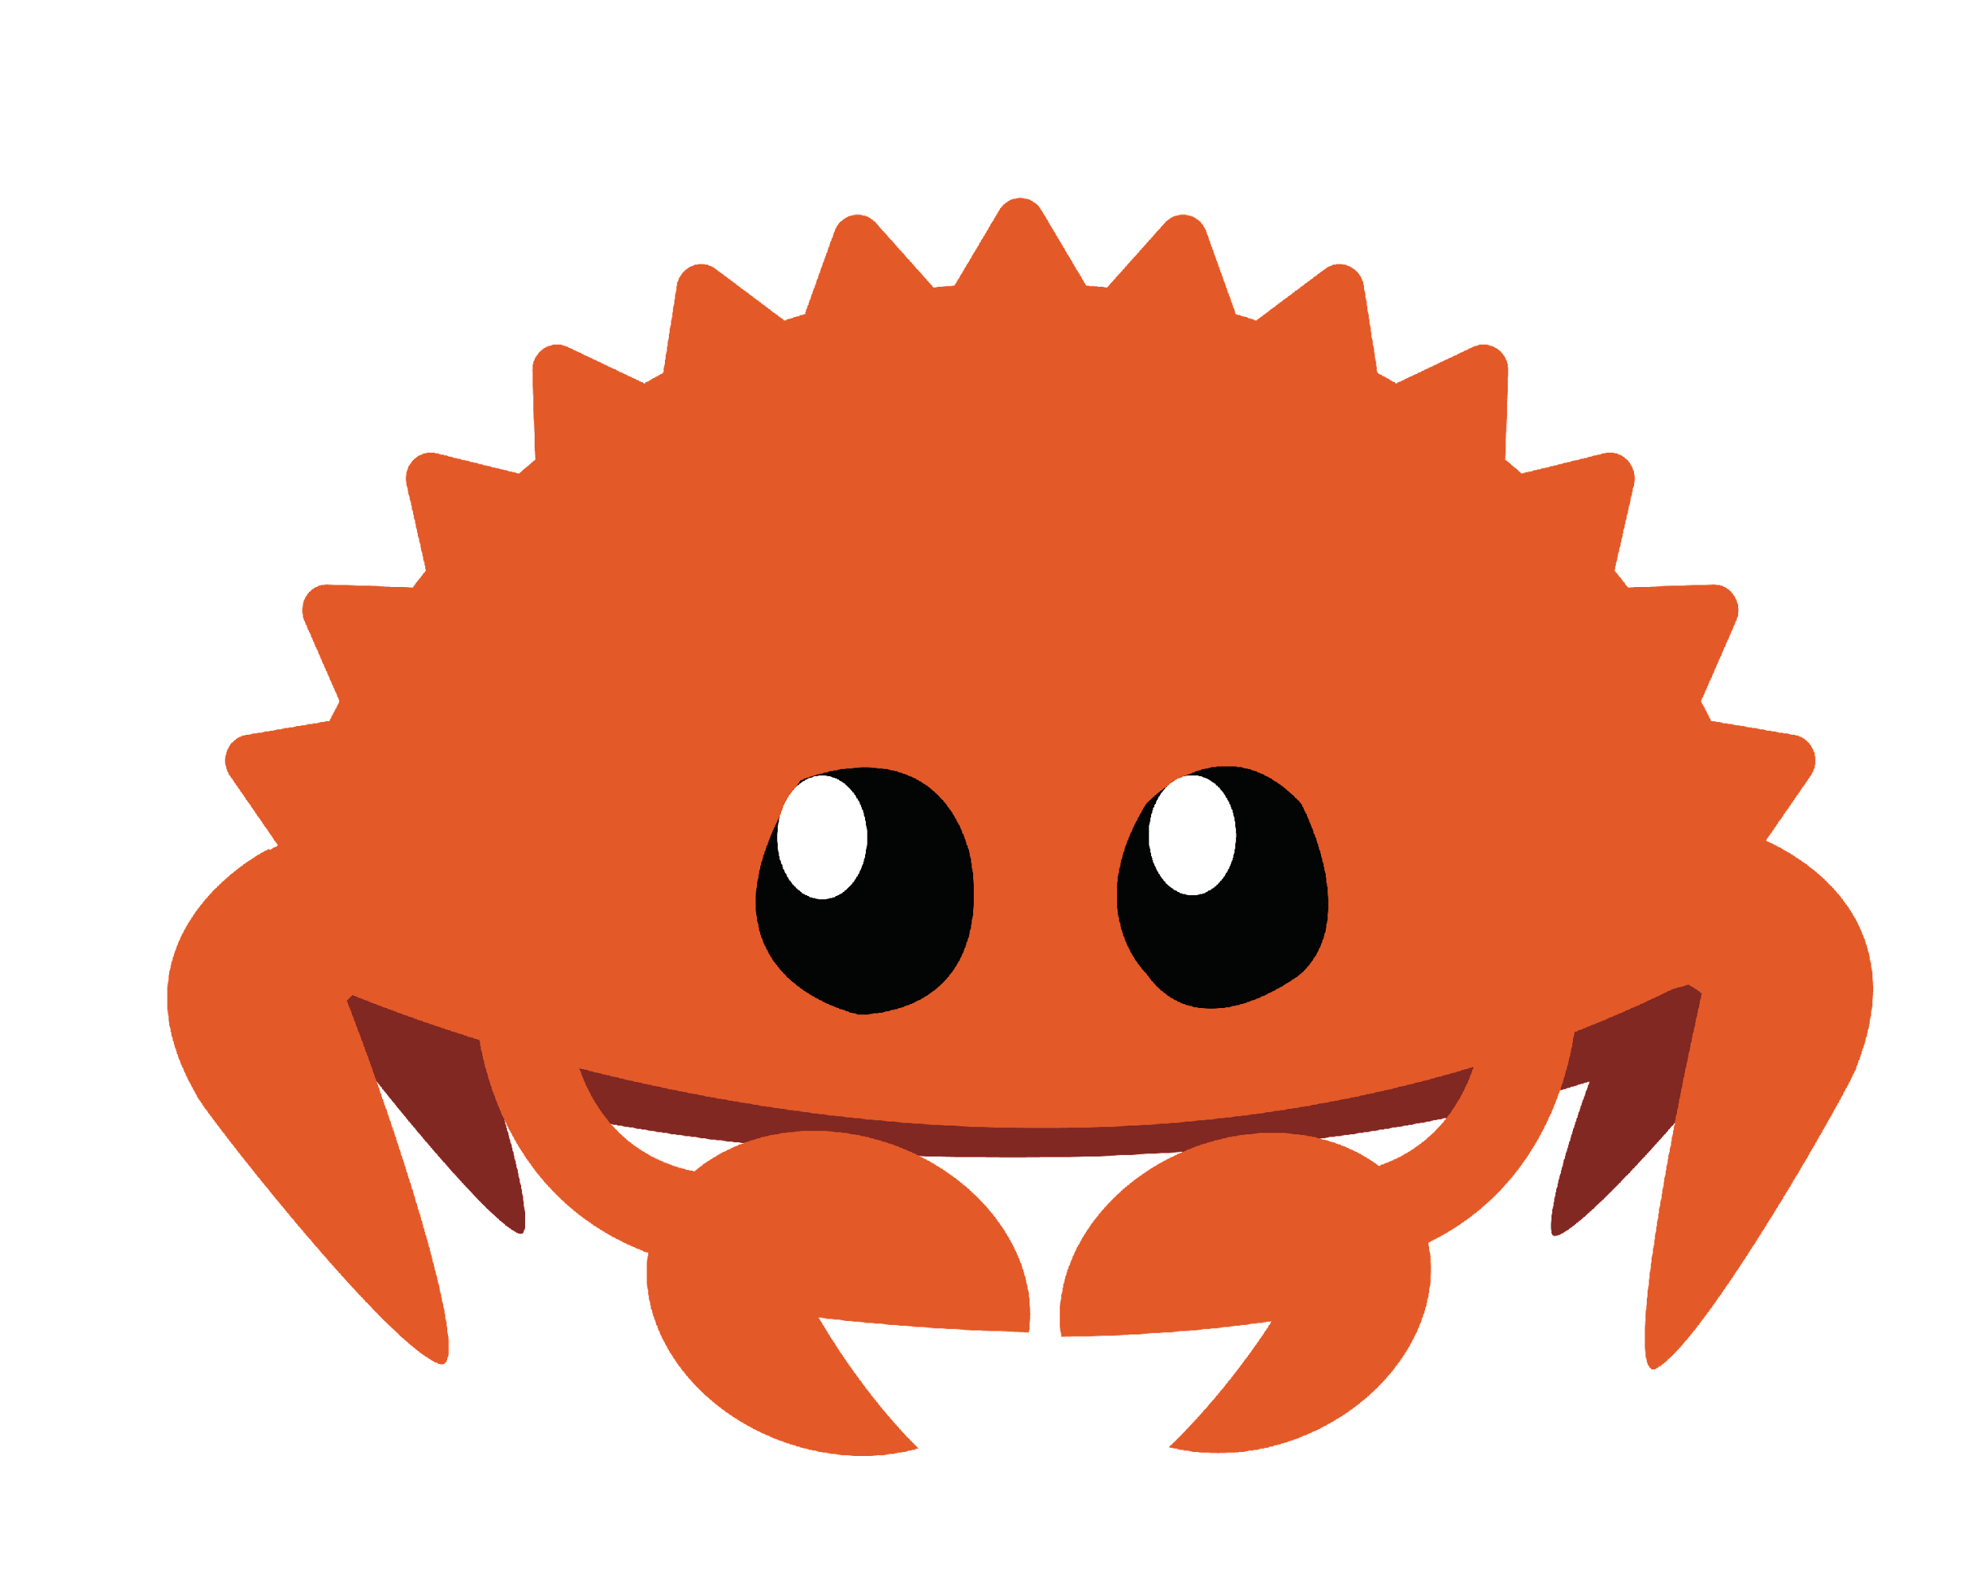
Use Rust to Develop the Decentralized Open Data Application
Mike Tang
daogangtang@gmail.com
@daogangtang
2023-06-08

Slide 3
互联网的终局
这是一个什么时代？
裁员
互联网格局定型
平台倒闭，数据丢失

Slide 4
互联网企业的发展模式
创业 -> 种子 -> 天使 -> A -> B -> C -> … -> IPO
创业的目的是？
赚钱盈利。建立一个好的平台，尽量粘住用户
代码：可能开源，可能不开源，绝大部分不开源。
数据？完全封闭。
数据是护城河，是信息时代的石油。

Slide 5
Where is the Next Stage
Web3? So-called Web3？

Slide 6
The Weapons Web3 Utilizes
Blockchain
Decentralized Ledger Storage: MPT (Merkle Patricia Tree)
K-V database
Smart Contract
Serverless

Slide 7
Problems of Web3: Technical Viewpoint
For mainstream tech stack, e. g. Ethereum
A world-wide unified network to provide a serverless layer
A single-core CPU machine
Is serverless really the next stage of Internet? Or just a gimmick by cloud platform
Wants to extend the financial computation/storage model to general cases
Limites of On-chain VM computation
Limites of MPT
Limites of K-V db

Slide 8
Dataset Models
Financial Model: Account=>Balance
Relatively closed dataset, linear increasement against account set
One dimension
Internet Model: Any
Open dataset, data will increase quickly on any dimension.
Multiple dimensions

Slide 9
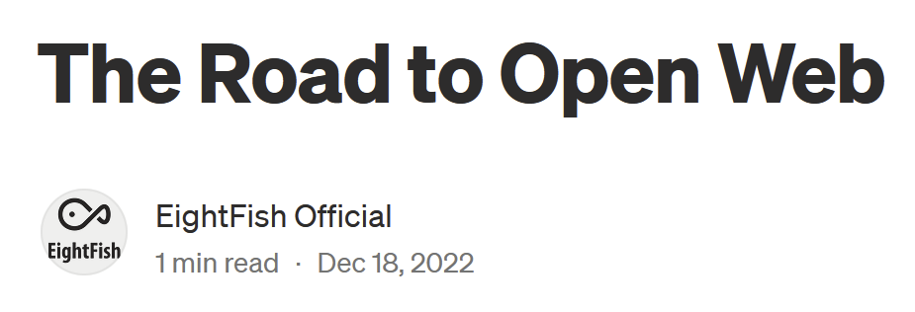
A New Proposal: Open Data Application
The Road to Open Web
What is open data?
Build an internet platform, but open its data to everyone.
Why we need open data?
The business of the closed data model has been at the end.

Slide 10
What An Open Data App Feels Like?
From the user side, it looks like just the traditional Internet app
But everyone have the chance to download/sync all open data from this platform
On the server side, it is a network, consisting of some/many nodes
Every node has a blockchain node in it

Slide 11
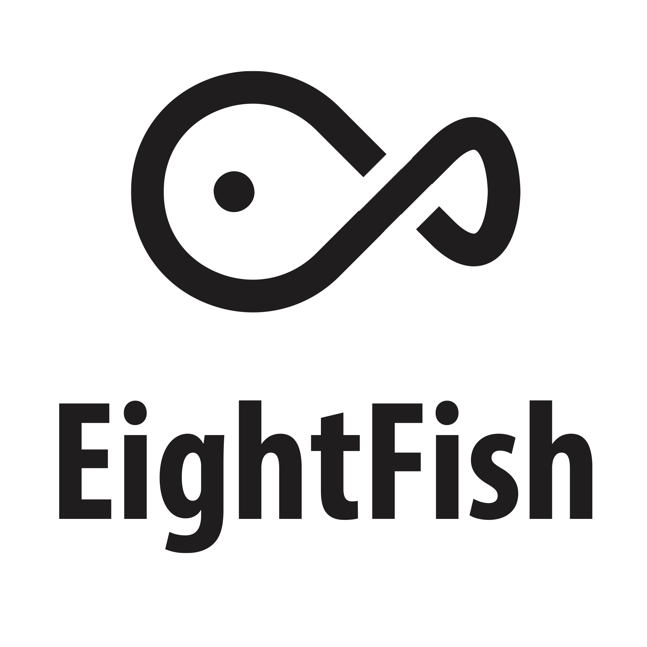
How to develop Open Data Application
“EightFish is a development framework (maybe the first one) for the Open Data Application (ODA), implementing the Open Data Application Model (ODAM). The theory of the ODA and ODAM is located here. In short description: EightFish powers ODAs, ODAs constitute the Open Web.”
https://github.com/eightfish-org/eightfish
EightFish intends to develop the Data-kind Decentralized Application.
You can use the traditional Web development coding style to develop a ODA.

Slide 12
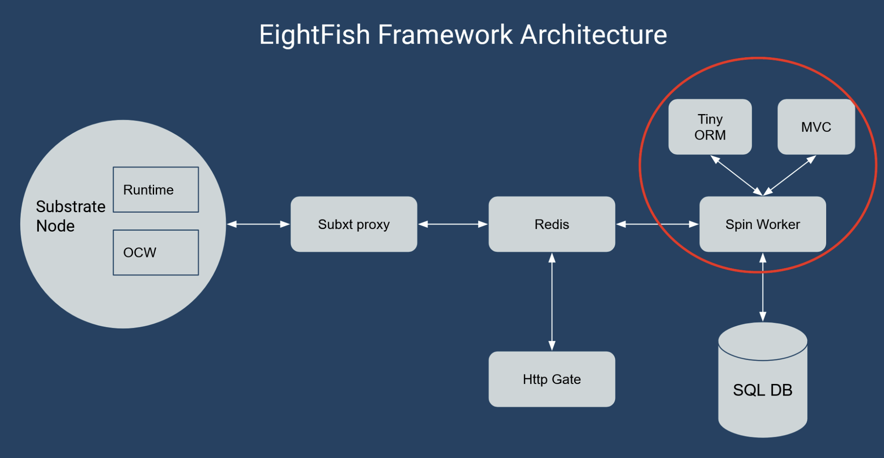
The EightFish Application Components

Slide 13
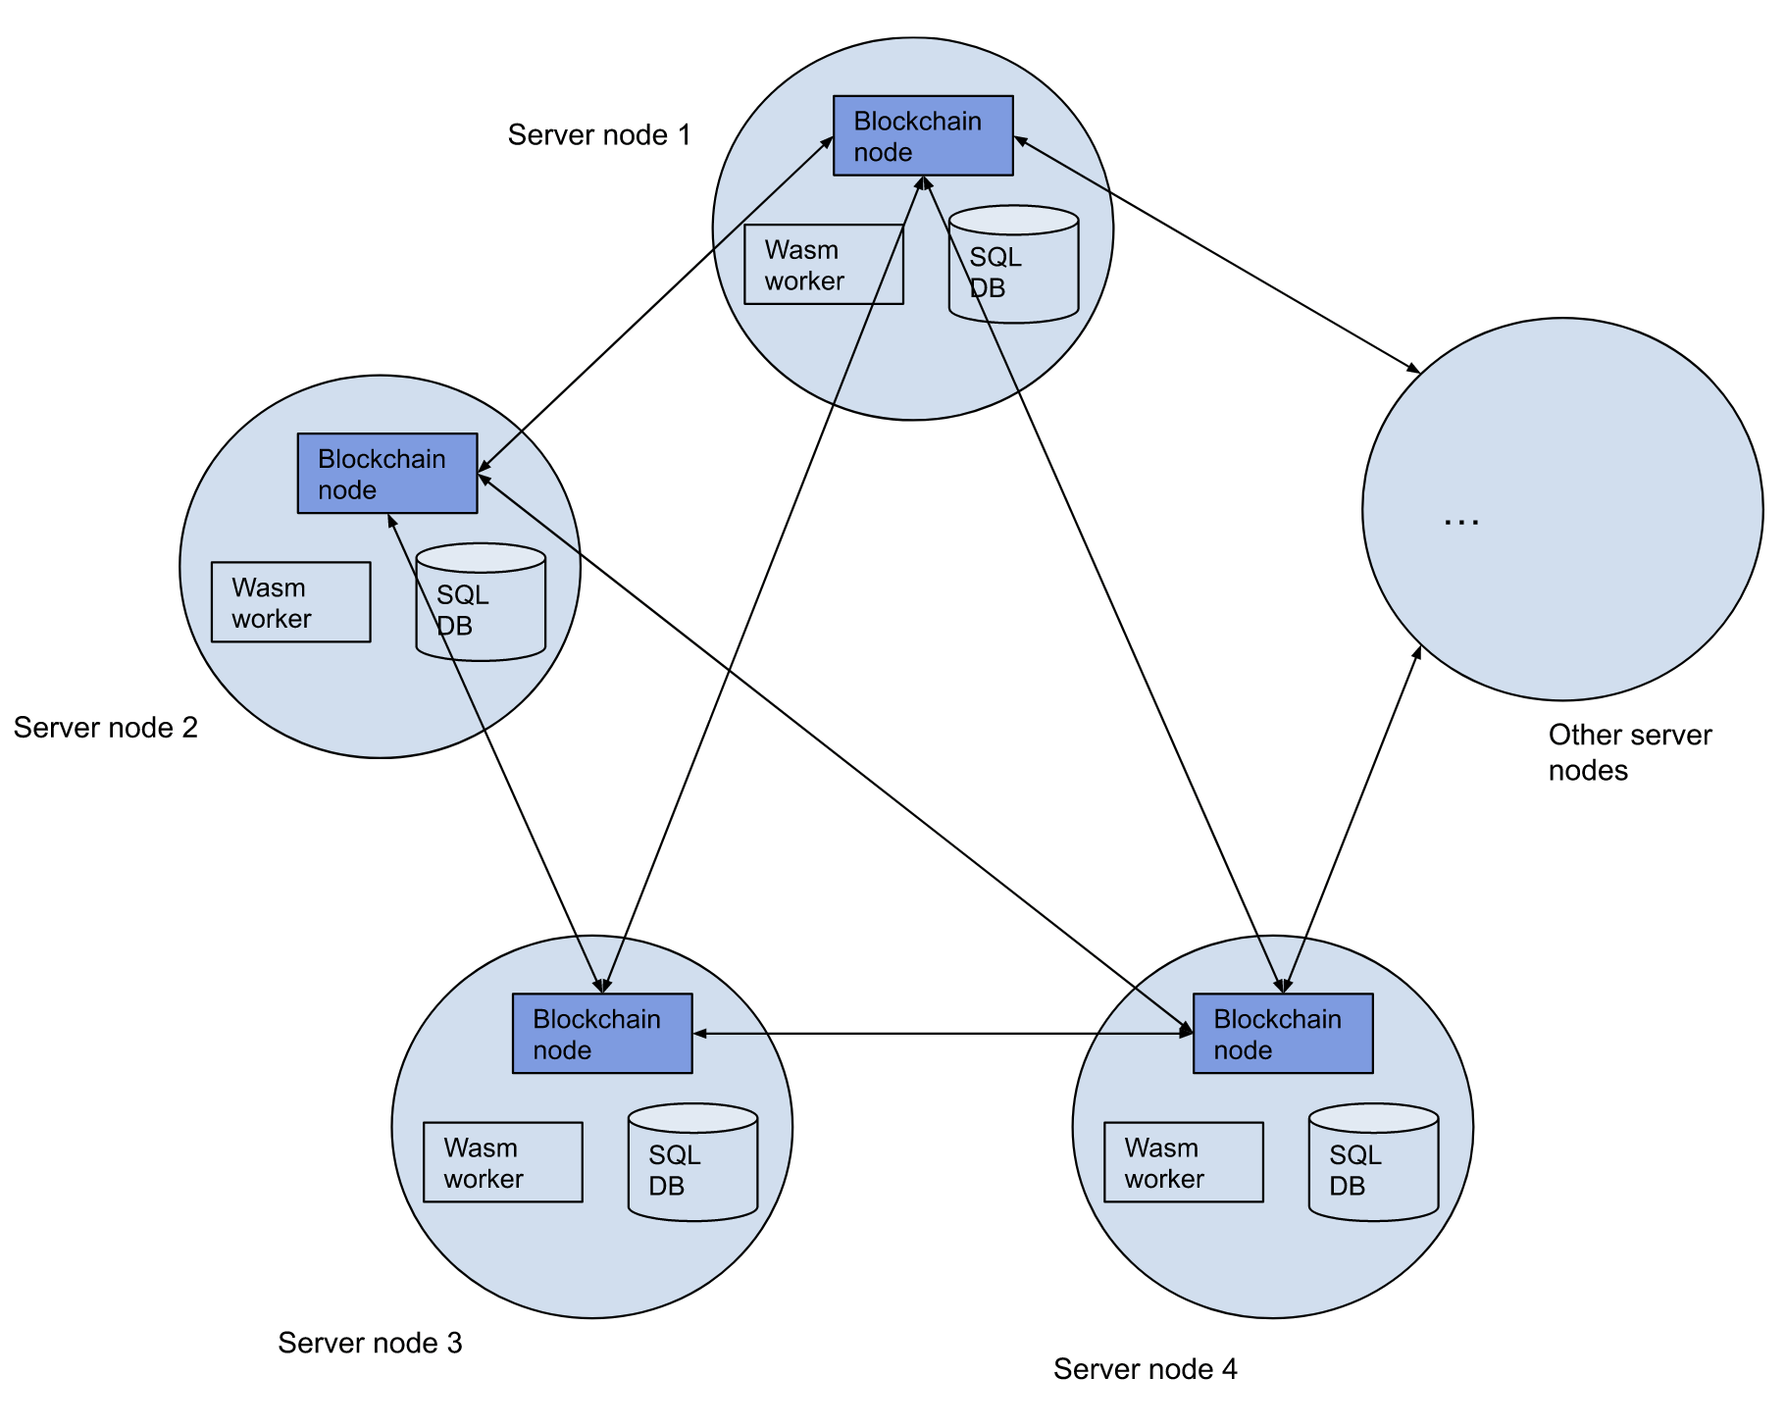
The EightFish Application Network Topology

Slide 14
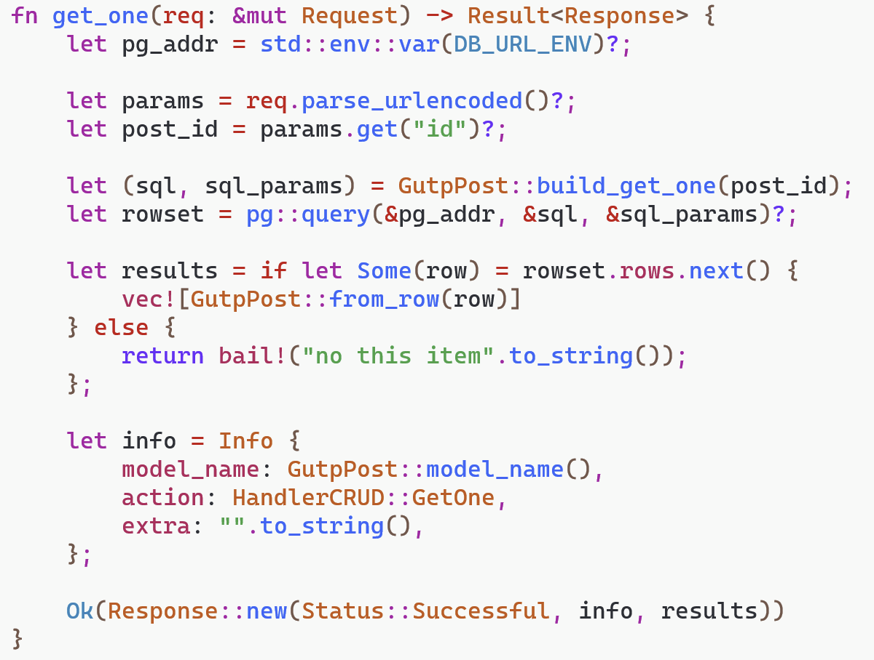
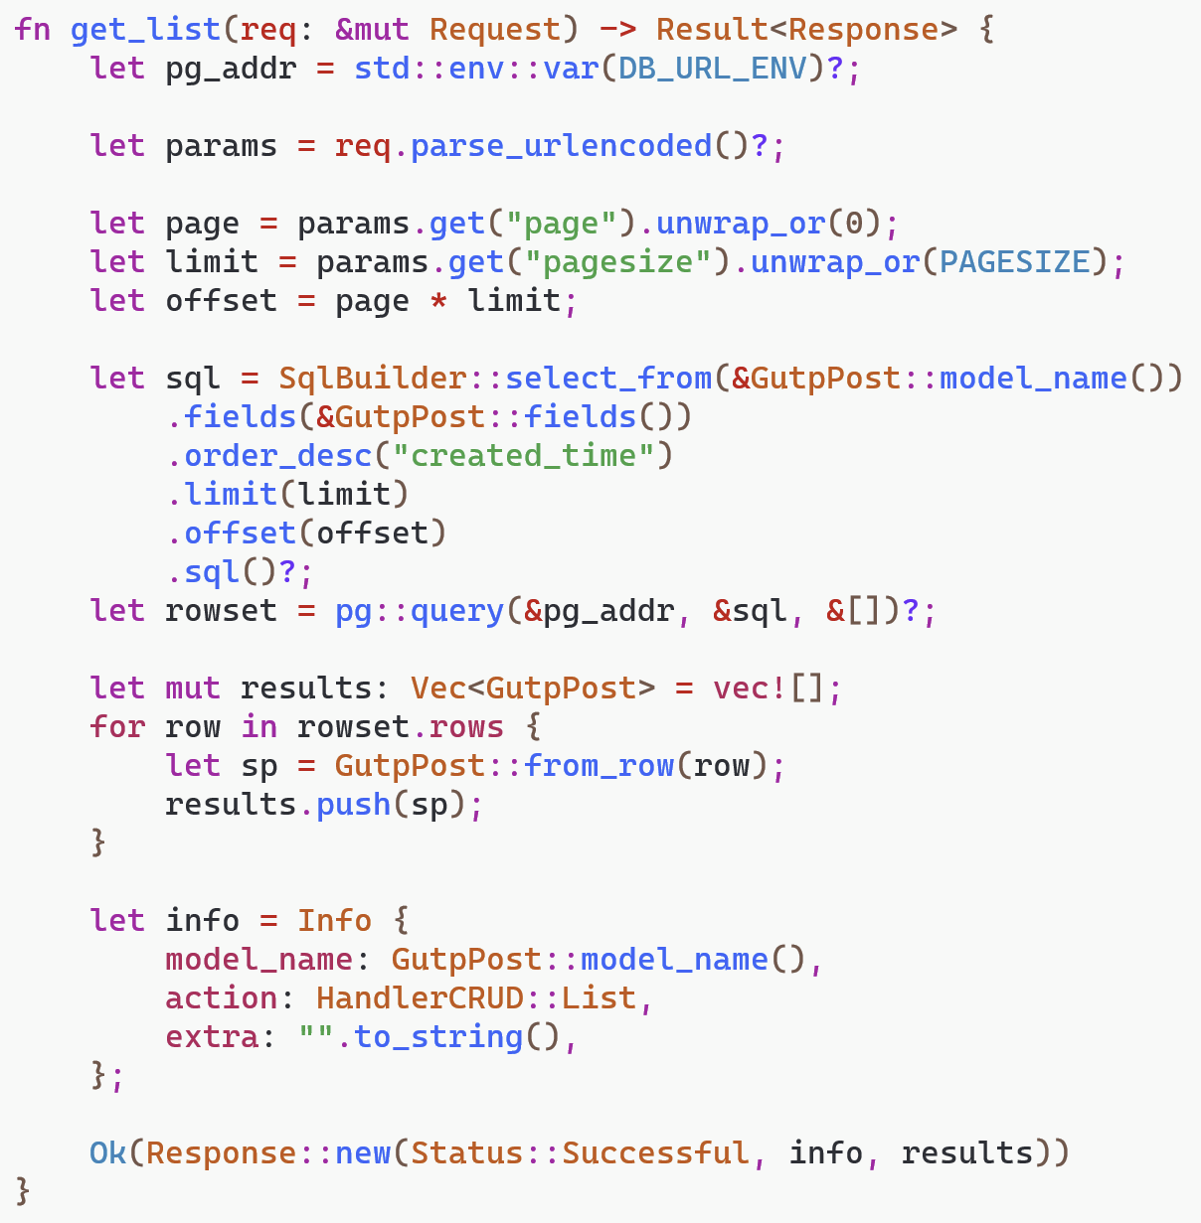
How to Write Logic

Slide 15
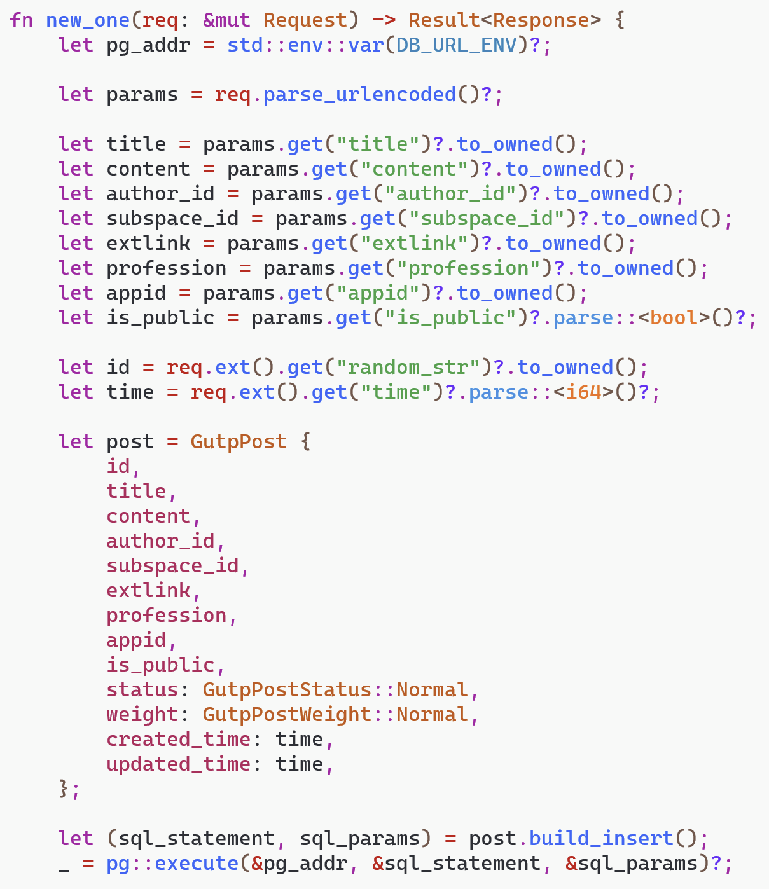
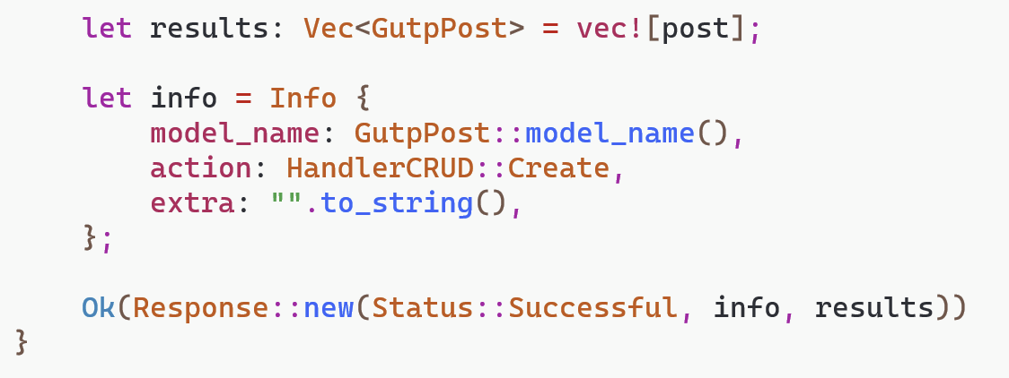
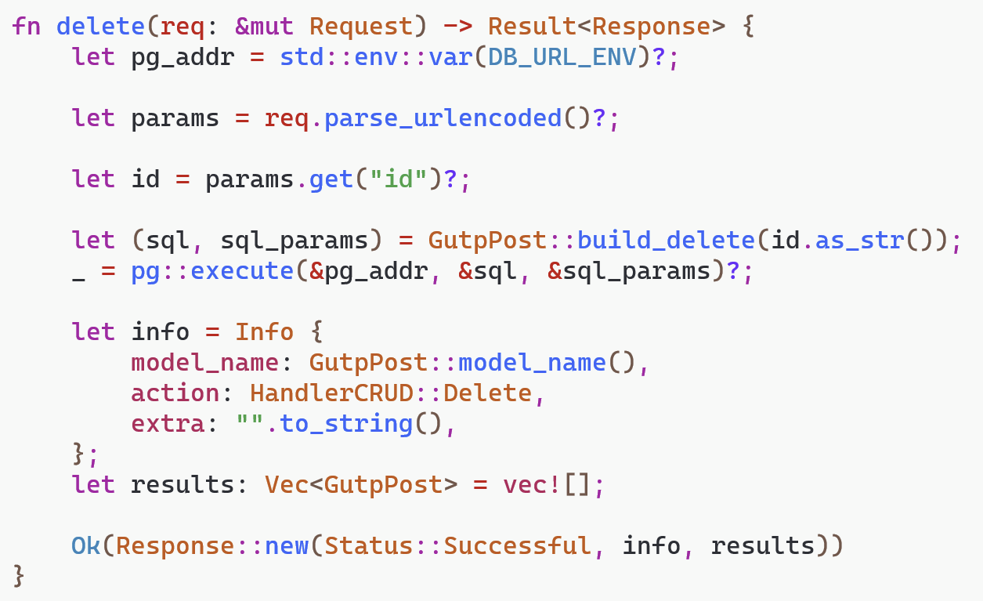
How to Write Logic

Slide 16
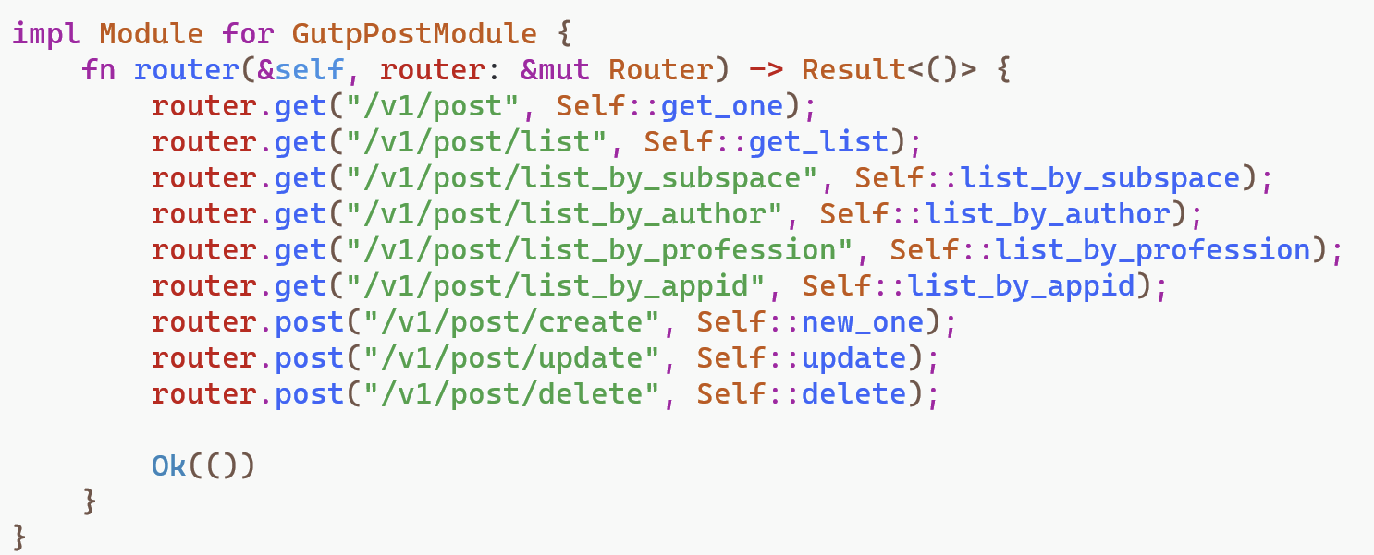
How to Write Logic

Slide 17
How to Test and Deploy
Docker compose, yaml configure file
One command to boot up and deploy
5 fixed EightFish services + 1 your customized app services
subnode
redis
+
=
ODA
subxt proxy
app biz
postgres
http gate

Slide 18
The EightFish Tech Stack
Rust
WebAssembly
Substrate
Wasmtime
Spin
Redis
Postgresql

Slide 19
One EightFish Network Hosts One Protocol
One EightFish network hosts one protocol, different protocols sit on different networks. (like appchains)
node1
node1
node2
node…
node2
node…
Protocol 1
Protocol 2
node3
node4
node3
node4

Slide 20
One Protocol Supports Multiple Applications
node1
app 1
app n
node2
node…
Protocol 1
node3
node4
app 2
app 3
Every app has its own backend and frontend implementations.

Slide 21
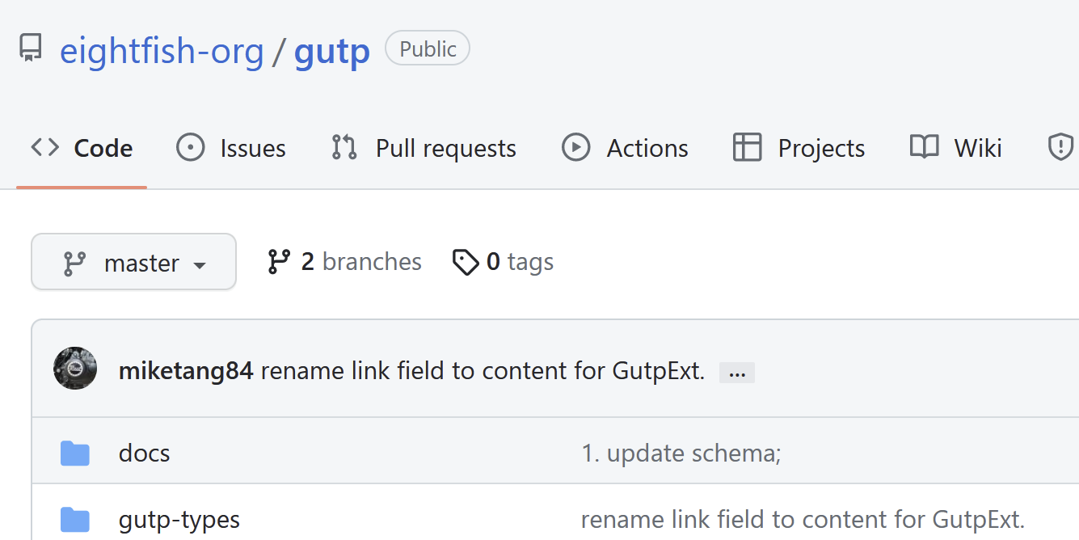
A Case: GUTP
General User Text Persistence protocol
https://github.com/eightfish-org/gutp

Slide 22
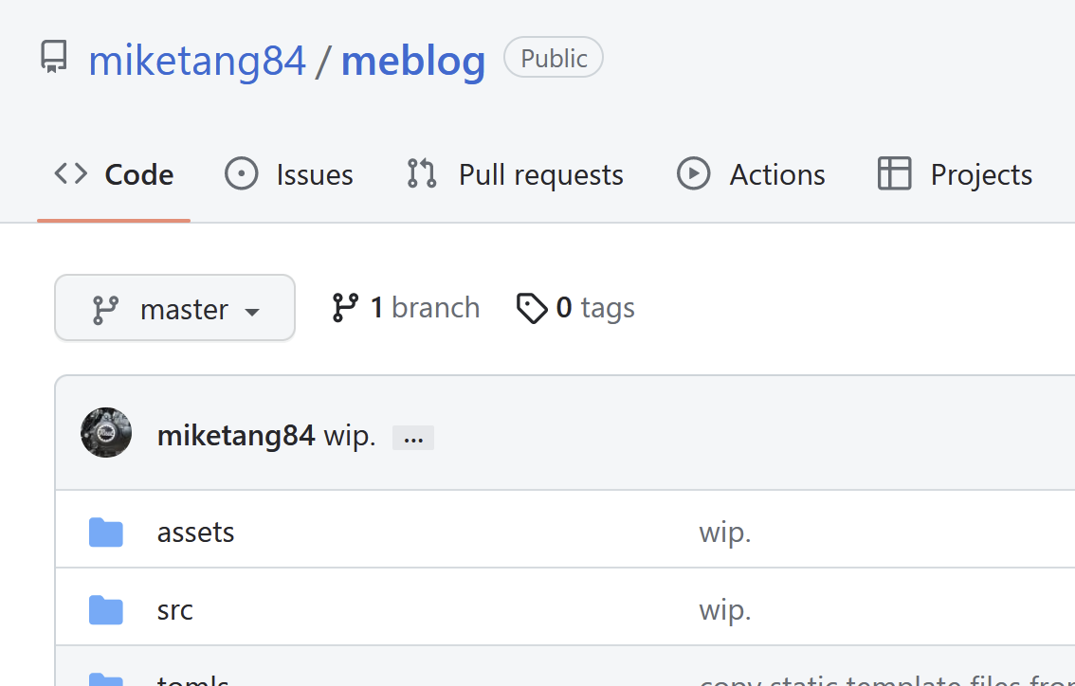
A Case: Meblog Connected to GUTP
MeBlog is a blog platform for users with the features of open-data and ownership.
https://github.com/miketang84/meblog

Slide 23
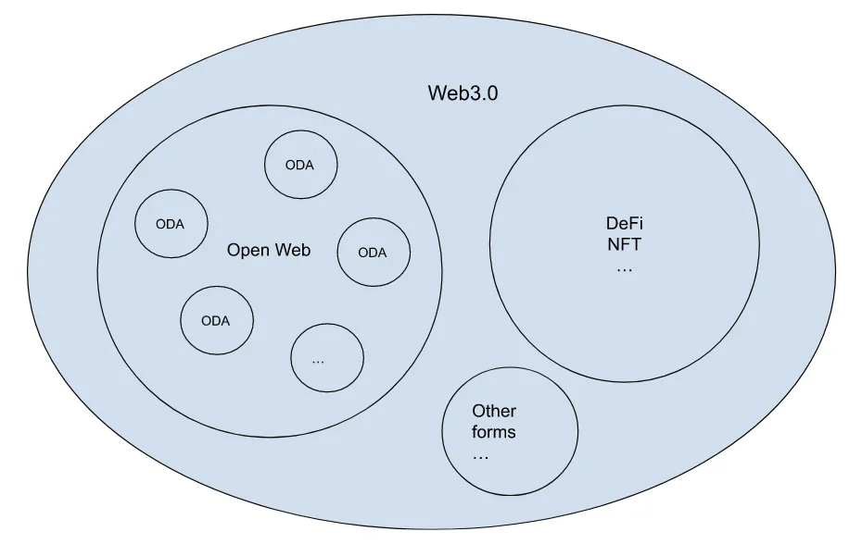
All Open Data Apps Constitute the Open Web

Slide 24
ODA vs Web2 app
 | Web2 App | Open Data App
Centralization | Centralized | Decentralized
Performance | High | High, less than Web2
Query Capability | Powerful | Powerful, less than Web2
Open Source Code | Open or Not, mostly NOT | Open
Data Resiliency | Normal | High
Data Openness | Closed | Open
Trustlessness | No | Yes

Slide 25
ODA vs Web3 DApp
 | Web3 DApp | Open Data App
Centralization | Decentralized | Decentralized
Underlying Nodes | Many | Few
Performance | Low | High
Query Capability | Low | High
Open Source Code | Open | Open
Hot Data Capacity | Low | High
Data Resiliency | High | High
Data Openness | Open | Open
Trustlessness | Yes | Yes

Slide 26
Core Difference Between ODA and Web3 DApp
Web3 DApp focuses on TOKEN and tokenizing other things
ODA focuses on DATA and the OPENNESS of the data

Slide 27
Two Major Problems
If I opened my database to others, how would I get profits from my efforts, how should I run my business?
How to attract more parties to run steady and persistent nodes for this platform?

Slide 28
An Initial Scheme
End user drives, no security (or token fund) drives.
Network is like a living creature, it will evolve – grow or die. The needs of the end users is the force to drive this network to evolve.
So what we should keep doing is to develop the scale of the end users.
More users, more data, more meanings.
The incoming depends on consumer traffics, not directly on user’s data.
More users, more incomings. The decentralization could probably reduce the cost, so you may get more profits.
More profits, more network nodes coming. They can share the profits of the overall network.

Slide 29
Idea: Open Data for Everyone’s AI
Open Data give EVERYONE the rights/chance to train your own AI model, by collecting the raw data source easily!
The rights of Raw Data Equality
The AI age requires Open Data/Open Web for people to counter the Giant Techs.

Slide 30
Thank you！

